Slide 1
SE2001 Software Requirement Engineering (SRE) Fall 2021
Sandia Kumari
Lecture # 1 & 2
September 6, 2021

Slide 2
Today
Who I am
How it started
Marks distribution
Textbooks
Rules
SE2001 educational objectives
Quick overview of SRE and why do we study it

Slide 3
Who I am
Sandia Kumari (sandia.kumari@nu.edu.pk)
Office 6 basement I, FAST-NUCES Main Campus.
Office Hours: Will update about it soon
Meeting me is the best way to resolve your queries otherwise you can email me at sandia.kumari@nu.edu.pk. But try to avoid email and visit my office.
Experience
10 months at Mehran, UET
5 months at Malaga Spain
3 months at HIAST
Spring 2021- FAST-NUCES

Slide 4
Marks Distribution
Homework assignments (10 weightage)
There will be four assignments
Midterm (15 x 2 = 30 weightage)
Group project (10 weightage)
A software requirements specification
Team of two
Final exam (50 weightage)

Slide 5
Textbook
Karl Wieger and Joy Beatty ,Software Requirements third edition, A division of Microsoft Corporation, 2013
Gerald Kotonya and Ian Sommerville, Requirements Engineering: Processes and Techniques, John Wiley & Sons, 1998
Geri Schneider and Jason Winters, Applying Use Cases: A Practical Guide, Second Edition, Addison-Wesley, 2006

Slide 6
Rules
Plagiarism is strictly prohibited (unethical)
Never beg for marks but earn marks
No submission is allowed after deadline. I’ll not consider your assignment after I’m done with checking.
No assignment/project marks discussion after finalization of marks like students come in the end of semester that we submitted our first assignment but you have not graded it. Never do that!
Your words and attitude are two important things. Therefore be careful in that. Follow give respect get respect rule.
Try to come in office hours in case of any query rather than emailing me.
Discipline is important
Avoid excuses for late submissions and other things.

Slide 7
How it started
No idea about programming
Admitted in Engineering uni
Loved programming
Experienced academics
Uni-life projects are different from industrial projects

Slide 8
About course
In this specialization, I hope to help you expand your knowledge, of the huge role that software requirements plays in every part of the Software Development Lifecycle.
And, also be providing you with many techniques, that will help you to efficiently and effectively, act as a liaison between your stakeholders, and all others on the software team.
While you do this, you're creating a living document that can lead to successful application.
Notes:
Liaison= contact

Slide 9

Example
If I ask you to purchase a laptop for me
Can you do that ?
No because you don’t know about the details like what specs I want ( RAM, Hard drive, Company, model etc).

Slide 10
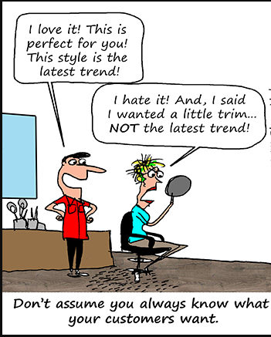
If someone says I want the same software but little bit different.
He doesn’t mean that at all!
They may want something similar, but it’s dangerous
for a developer to think of the product as the product
he knew already, and just work to convert it.
After sometime, you learn that it wasn't what was
wanted or needed at all.
You didn't know the list of requirements well

Slide 11


When starting any software project, an extremely critical part is to learn what the customer actually wants and needs and define that clearly for our developers.

Slide 12

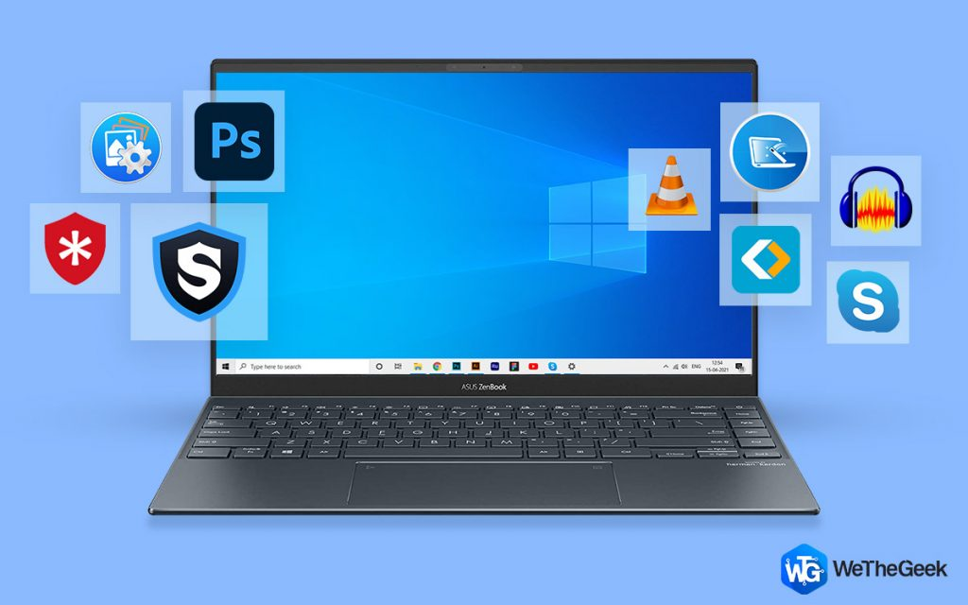
As a requirements engineer, you're playing a really exciting role in fully learning about the system that was and the system to be

Slide 13
RE: The basis of Software Development
Requirements Engineers
Software Engineers / Designers
Development / Product Managers
Software Testers / QA
Technical Document Writers
Security Engineers
Product Analysts
Graduate students seeking degree/certificate in SE or CS

Slide 14


Why this course?
While the requirements task is quite daunting especially for new requirements engineers, this courses will teach you the techniques and tips that can help you to succeed.

Slide 15
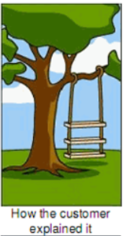
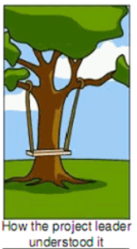
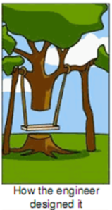
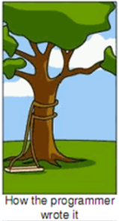
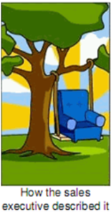
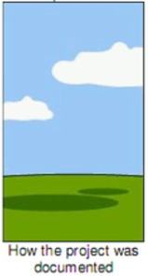
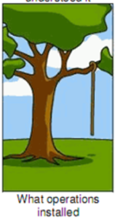
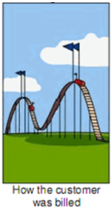

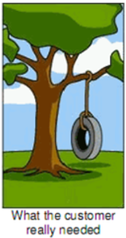
Let’s see how it’s daunting/ difficult task

Slide 16
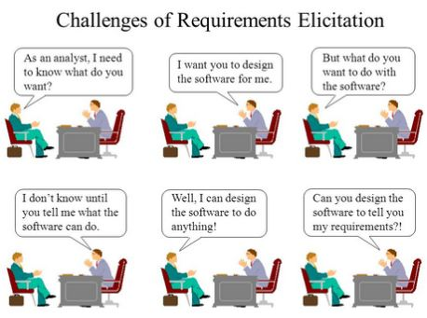
Sometimes we have customers like this…

Slide 17


Background
The development of computer-based systems has been plagued with problems since the 1960s. Too many systems may be delivered late and over budget.
They don’t do what users really want and they are often never used to their full effectiveness by the people who have paid for them. There is rarely a single reason (or a single solution) for these problems but we know that a major contributory factor is problems with system and software requirements

Slide 18
Requirements:
The term requirement is not used consistently in the software industry.
In some cases, a requirement is simply a high-level, abstract statement of a service that a system should provide or a constraint on a system.
At the other extreme, it is a detailed, formal definition of a system function.

Slide 19
System Requirements
As the name suggest, system requirements define what the system is required to do and the circumstances under which it is required to operate.
The requirements define the services that the system should provide and they set out constraints on the system’s operations

Slide 20
Types of requirements
Very general requirements which set out in broad terms what the system should do.
Functional requirements which define part of the system’s functionality.
Implementation requirements which state how the system must be implemented.
Performance requirements which specify a minimum acceptable performance for the system.
Usability requirements which specify the maximum acceptable time to demonstrate the use of the system.

Slide 21

Example
Some examples requirements for a library system.
The system shall maintain records of all library materials including books, serials, newspapers and magazines, video and audio tapes, reports, collections of transparencies, computer disks and CD-ROMs.
2. The system shall allow users to search for an item by title, author, or by ISBN.
3. The system’s user interface shall be implemented using a World-Wide-Web browser.
4. The system shall support at least 20 transactions per second.
5. The system facilities which are available to public users shall be demonstrable in 10 minutes or less.

Slide 22
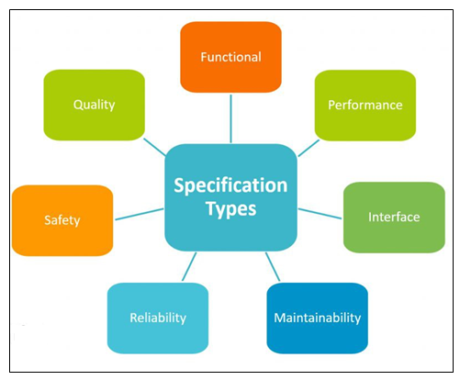
So many different types requirements, it isn’t possible to describe a standard way of writing requirement or to define the ‘best’ way to specify requirements

Slide 23

Quiz
What is a SRS?
Software Resolution Specification Document
Software Requirements Specification Document
Scope of Requirements Specification Document

Slide 24
What are non-functional requirements?
Requirements that address how the system should operate.
Requirements that specify what the system should do.
Requirements that do not work.
Requirements that are in conflict with the SRS.

Slide 25
What answer best identifies some of the challenges as you develop the SRS?
Adding additional features, making assumptions, and going out of scope.
Where and how ideas are developed such as on a napkin or a whiteboard
Customers who know what they want but their ideas or answers to your questions are ambiguous.
All of the above

Slide 26
Which answer best describes the consequences of writing bad requirements?
Lack of user input, incomplete requirements, changing requirements, and are the most expensive to fix.
Customers who overall are satisfied with the requirements.
Hidden bugs or errors that cause the software to loop.

Slide 27
Requirements Problem
The requirements don’t reflect the real needs of the customer for the system.
Requirements are inconsistent and/or incomplete.
It is expensive to make changes to requirements after they have been agreed.
There are misunderstandings between customers, those developing the system requirements and software engineers developing or maintaining the system.

Slide 28
Example
The system shall Allow user to search an item by title, author or ISBN
The problems of writing Req. are universal and there will never be a complete solution to these problems. However good req engineering practice can reduce number of problems

Slide 29
FAQS about requirements
What are requirements?
A statement of a system service or constraint
What is requirements engineering?
The processes involved in developing system requirements
How much does requirements engineering cost?
About 15% of system development costs
What is a requirements engineering process?
The structured set of activities involved in developing system requirements

Slide 30
FAQs contd.
What happens when the requirements are wrong?
Systems are late, unreliable and don’t meet customers needs
Is there an ideal requirements engineering process?
No - processes must be tailored (adapt) to organizational needs
What is a requirements document?
The formal statement of the system requirements
What are system stakeholders?
Anyone affected in some way by the system

Slide 31
FAQs contd.
What is the relationship between requirements and design?
Requirements and design are interleaved. They should, ideally, be separate processes but in practice this is impossible
What is requirements management?
The processes involved in managing changes to requirements

Slide 32
What is RE?
It covers the following activities:
Discovering
Documenting
Maintaining
A Set of Req. for a CBIS.
Engineering implies that systematic and repeatable techniques should be used to ensure that system requirements are complete, consistent relevant etc.

Slide 33
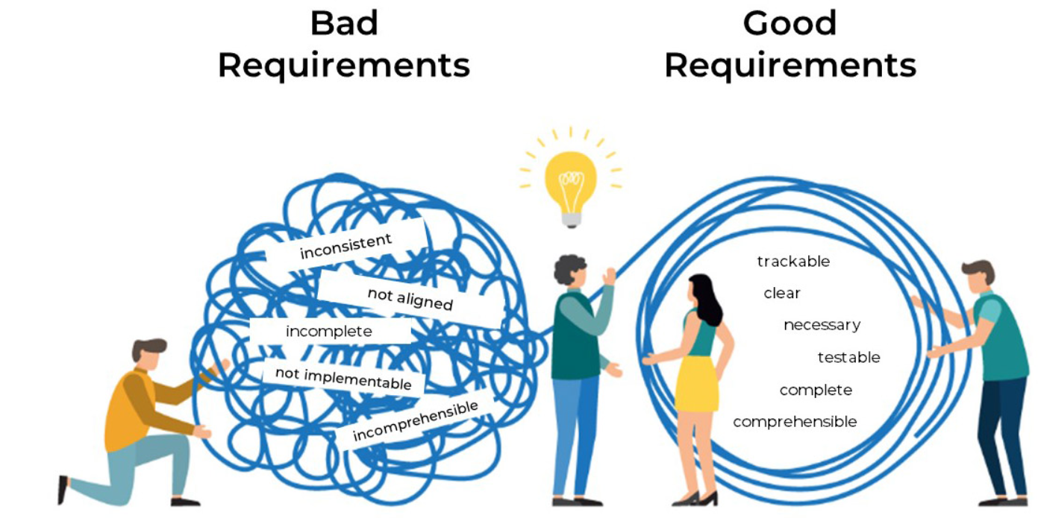
Engineering implies that systematic and repeatable techniques should be systematic and repeatable techniques to ensure that system req are complete, consistent, relevant etc.

Slide 34
How much RE cost?
Depends on the type and size of system being developed and exactly what activities are included under RE.
According to surveys
For large software/ hardware systems , about 15% of the total budget is taken by requirement engineering activities and for small 10%.

Slide 35
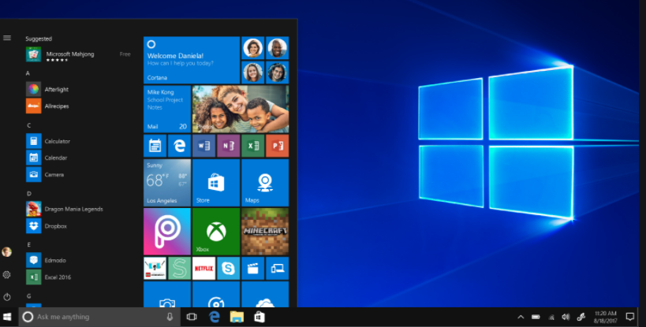
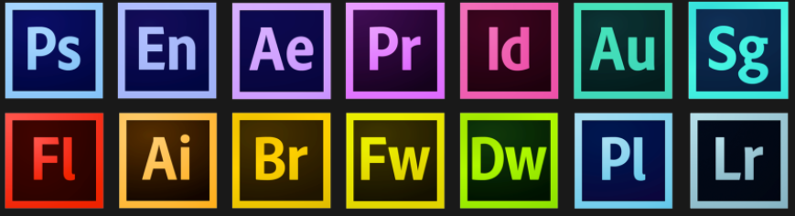
Systems engineering
There is a close relationship between software and more general system requirements. It is impossible to separate the requirements for the software from broader requirements for the system as a whole.
Computer-based systems fall into two broad categories:
User-configured systems where a purchaser puts together a system from existing software products.

Slide 36


Custom systems where a customer produces a set of requirements for hardware/software system and a contractor develops and delivers that system

Slide 37
SE2001 Software Requirement Engineering (SRE) Fall 2021
Sandia Kumari
Lecture # 3
September 9, 2021

Slide 38
Classes of custom systems
Information systems
Primarily concerned with processing information which is held in some database.
Embedded systems
Systems where software is used as a controller in some broader hardware system
Command and control systems
Essentially, a combination of information systems and embedded systems where special purpose computers provide information which is collected and stored and used to make decisions.

Slide 39
Emergent properties
Emergent properties are properties of the system as a whole and only emerge once all of its individual sub-systems have been integrated.
Examples of emergent properties
Reliability
Maintainability
Performance
Usability
Security
Safety
System requirements are often concerned with these emergent properties & therefore not solely concerned with the system’s functionality

Slide 40

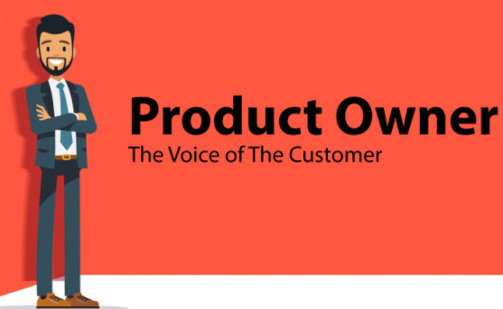
Do you know?
Who’s Business Analyst and Product Owner?

Slide 41
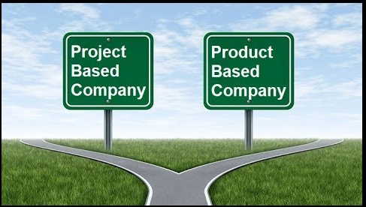
Project vs Project based companies

Slide 42
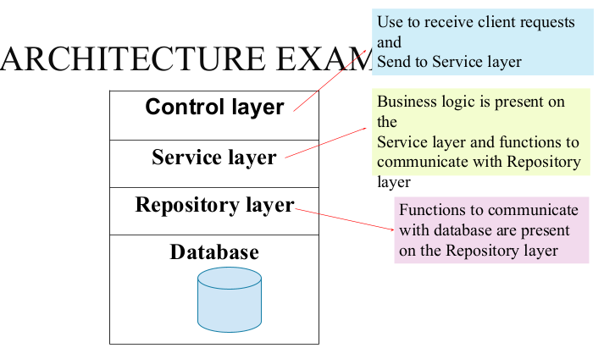

Slide 43

If we talk about Agile User Stories
No requirement engineering activity in agile methods
Gathered requirements are integrated with development
To make this easier, the idea of “user stories” was developed
Together (System customer & development team) they develop a “story card” that briefly describes a story that encapsulates the customer needs

Slide 44
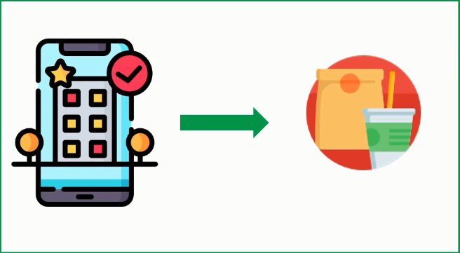
Case Study
Restaurant called “Karachi Cuisines” is looking for an Online Home Delivery Service for her Restaurant.
Ali is the Business Analyst part of the Consulting firm who is hired to set this up. He is going to use the User Story Mapping Technique to gather Business Requirements and for release prioritisation

Slide 45
EPIC
EPIC
EPIC
EPIC
Browse
Order
Pay
Track
Activity
Sequence
User
Story
User
Story
User
Story
User
Story
Grouped by
Categories
Registration
Cash
ETA
Release1
User
Story
User
Story
User
Story
User
Story
Search by keyword
Login
Debit/Credit
Card
Support
User
Story
Add & Remove
From Cart
Release2
User
Story
User
Story
Internet Banking
Order Progress
User
Story
User
Story
Release 3
Duplicate Previous Orders
User
Story
Payment Wallets
Live Tracking

Slide 46
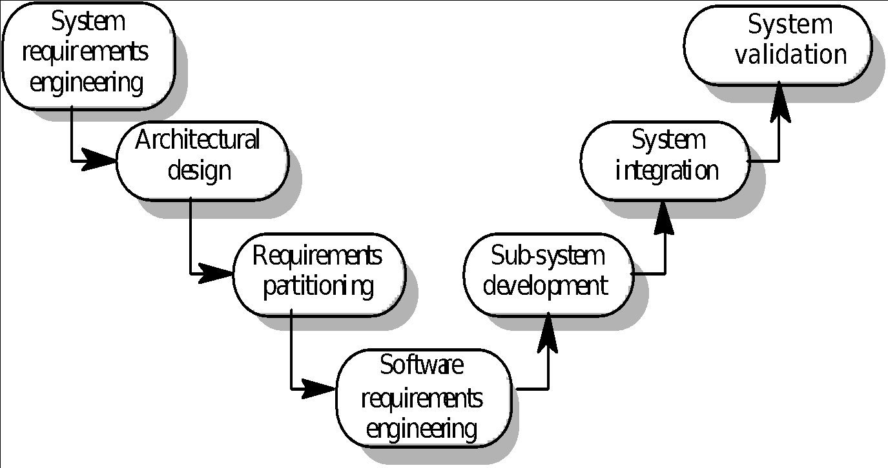
The systems engineering process

Slide 47
System engineering activities
System requirements engineering
The requirements for the system as a whole are established and written to be understandable to all stakeholders
Architectural design
The system is decomposed into sub-systems
Requirements partitioning
Requirements are allocated to these sub-systems
Software requirements engineering
More detailed system requirements are derived for the system software

Slide 48
System engineering activities
Sub-system development
The hardware and software sub-systems are designed and implemented in parallel.
System integration
The hardware and software sub-systems are put together to make up the system.
System validation
The system is validated against its requirements.

Slide 49
Requirements document
The requirements document is a formal document used to communicate the requirements to customers, engineers and managers.
The requirements document describes:
The services and functions which the system should provide
The constraints under which the system must operate
Overall properties of the system i.e.. constraints on the system’s emergent properties
Definitions of other systems which the system must integrate with.
Info. about the application domain (How to carry out specific task/computation).
Constraints on the process.

Slide 50
Requirements document structure
IEEE/ANSI 830-1993 standard proposes a structure for software requirements documents
1. Introduction
1.1 Purpose of requirements document
1.2 Scope of the product
1.3 Definitions, acronyms and abbreviations
1.4 References
1.5 Overview of the remainder of the document

Slide 51
Requirements document structure
2. General description
2.1 Product perspective
2.2 Product functions
2.3 User characteristics
2.4 General constraints
2.5 Assumptions and dependencies
3. Specific requirements
Covering functional, non-functional and interface requirements.
4. Appendices
5. Index

Slide 52
Users of requirements documents
System customers
specify the requirements and read them to check they meet their needs
Project managers
Use the requirements document to plan a bid for system and to plan the system development process
System engineers
Use the requirements to understand the system being developed
System test engineers
Use the requirements to develop validation tests for the system
System maintenance engineers
Use the requirements to help understand the system

Slide 53
Adapting the standard
The IEEE standard is a generic standard which is intended apply to a wide range of requirements documents.
In general, not all parts of the standard are required for all requirements documents
Each organisation should adapt the standard depending on the type of systems it develops
Consider a company (XYZ) that develops scientific instruments

Slide 54
Organization XYZ standard
Preface
This should define the expected readership of the document and describe its version history including a rationale for the creation of a new version and a summary of the changes made in each version.
Introduction
This should define the product in which the software is embedded, its expected usage and present and overview of the functionality of the control software.
Glossary
This should define all technical terms and abbreviations used in the document.

Slide 55
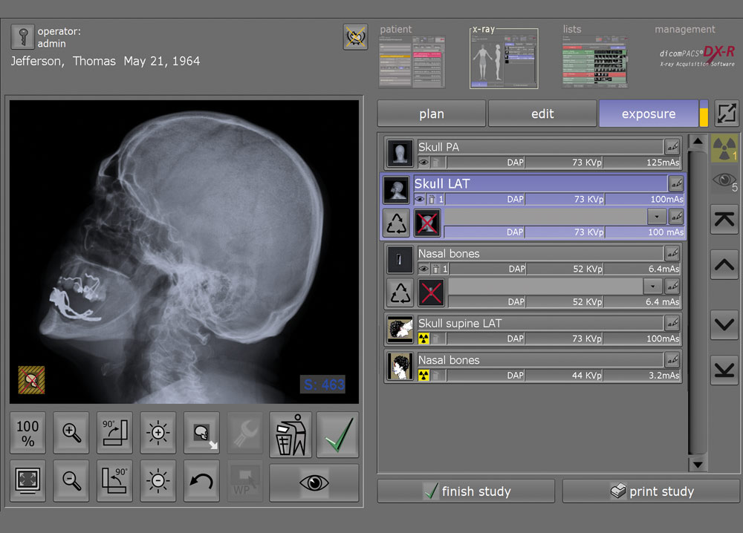
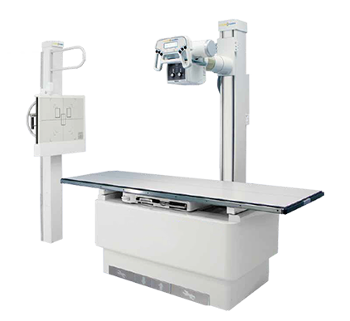
Like in intro section

Slide 56
Organization XYZ standard
General user requirements
This should define the system requirements from the perspective of the user of the system. These should be presented using a mixture of natural language and diagrams.
System architecture
This chapter should present a high-level overview of the anticipated system architecture showing the distribution of functions across system modules. Architectural components which are to be reused should be highlighted.
Hardware specification
This is an optional chapter specifying the hardware that the software is expected to control. It may be omitted if the standard instrument platform is used

Slide 58
Organization XYZ standard
Detailed software specification
This is a detailed description of the functionality expected of the software of the system. It may include details of specific algorithms which should be used for computation. If a prototyping approach is to be used for development on the standard instrument platform, this chapter may be omitted.
Reliability and performance requirements
This chapter should describe the reliability and performance requirements which are expected of the system. These should be related to the statement of user requirements in Chapter 4.

Slide 59
Organization XYZ standard
The following appendices may be included where appropriate:
Hardware interface specification
Software components which must be reused in the system implementation
Data structure specification
Data-flow models of the software system
Detailed object models of the software system
Index

Slide 60
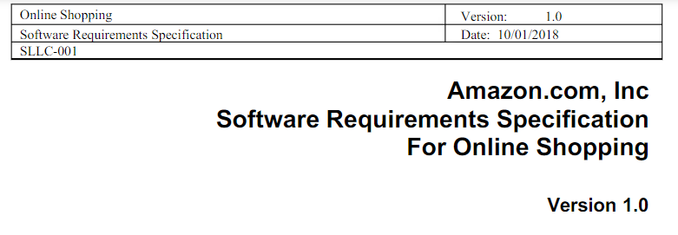
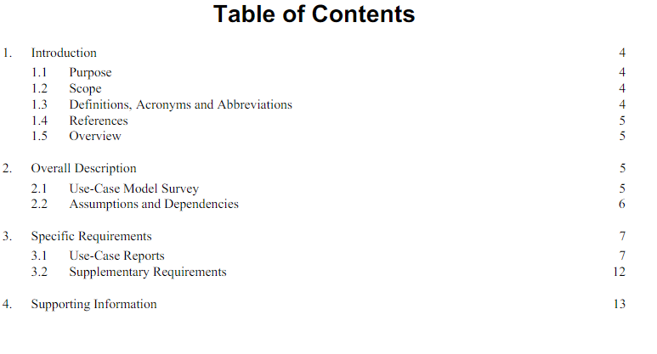

Slide 61
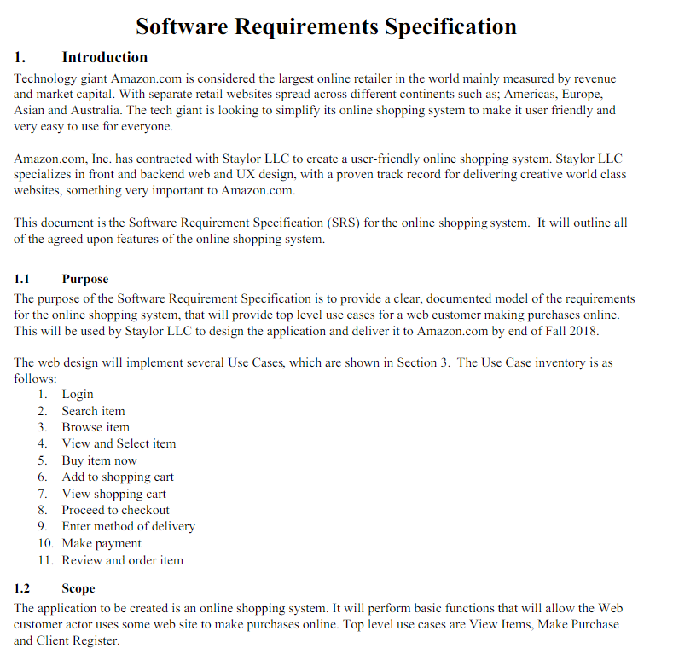

Slide 62
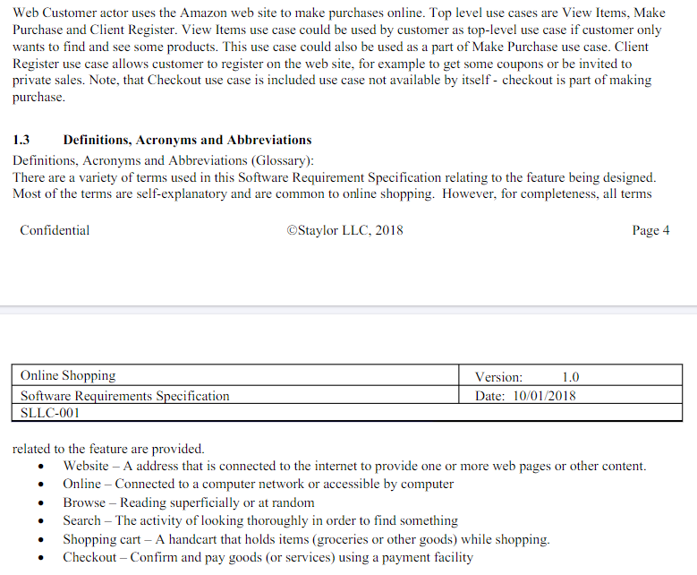

Slide 63
Writing essentials
Requirements are read more often than they are written. You should invest time to write readable and understandable requirements
Do not assume that all readers of the requirements have the same background and use the same terminology as you
Allow time for review, revision and re-drafting of the requirements document

Slide 64
Writing guidelines
Define standard templates for describing requirements
Use language simply consistently and concisely
Use diagrams appropriately
Supplement natural language with other description of requirements
Specify requirements quantitatively

Slide 65
Chapter review
Requirements define what the system should provide and define system constraints
Requirements problems lead to late delivery and change requests after the system is in use
Requirements engineering is concerned with eliciting, analyzing, and documenting the system requirements
The requirements document is the definitive specification of requirements for customers, engineers and managers.
The requirements document should include a system overview, glossary, statement of the functional requirements and the operational constraints

Slide 66
Exercises
Explain the problems which might arise if the following requirements were included in a requirements document for a library system:
The system shall provide an easy-to-use graphical interface based on MS Windows XP. Accredited users should have privileged access to the cataloguing facilities of the system
The system software shall be implemented using separated modules for cataloguing, user access and archiving.
List possible stakeholders for a library cataloguing systems
Suggest how the following requirements might be rewritten in a quantitative way
The library system shall be easy-to-use.
The library system shall provide reliable service to all classes of users.
The library system shall provide a rapid response to all user requests for book information.

